Slide 1


DEPARTMENT OF BIOCHEMISTRY
ISWAR SARAN DEGREE COLLEGE
(A CONSTITUENT PG COLLEGE OF UNIVERSITY OF ALLAHABAD)
TOPIC
nutritional and parasitic disease
Presented by,
Sneha Gupta
BSc 3 year

Slide 2
contents
Nutritional disease
Introduction and types
undernutrition
Kwashiorkor or marasmus
Mineral deficiencies
Calcium, iron, iodine or iodine deficiencies
overnutrition
Obesity or weight gain
Parasitic disease
Introduction, types of parasites and mode of transmission
Common
Parsitic disease
Ascariasis, dengue or malaria

Slide 3

Nutritional disease

Slide 4
Nutritional disease
Introduction
A nutritional deficiency occurs when the body does not absorb or get from food the necessary amount of nutrient. Deficiencies can lead to a variety of health problems. These can include digestion problems, skin disorders, stunted or defective bone growth, and even dementia
Factors affecting -
Biological factors
Superstitions
Social and cultural factors
Religious factors
Income
Geography/ availability
Psychological factors
Prevention – healthy diet very essential. Getting enough exercise. To educate the public about nutrition and their disease and how to prevent

Slide 5
Parts of nutritional disease
Nutritional disease
protein disease
Mineral disease
Vitamin disease
Iron deficiencies
Calcium deficiencies
undernutrition
overnutrition
Fat soluble deficiency
water soluble deficiency

Slide 6
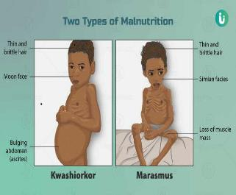
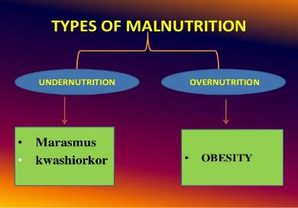
malnutrition
introduction….
state of poor nutrition
from insufficient/ excessive/ unbalanced diet
poor absorption of food/ excessive loss of essential of food nutrients
Nutritional insufficiency – undernutrition
Excessive nutrition - overnutrition
Major cause
Starvation, Political problems, Poverty
Natural disaster, war
Vitamin deficiency
Defective digestion or defective absorption

Slide 7
undernutrition
………………

Slide 8
Protein energy malnutrition
Protein Energy Malnutrition (PEM) is defined as a range of pathological conditions arising from coincident lack of varying proportions of protein and calorie, occurring most frequently in infants and young children and often associated with infection (WHO,1973) PEM affects children under 5 years of age belonging to the poor under privileged communities .Under nutrition is a complex condition with multiple deficiencies such as proteins , energy and micro nutrient deficiencies often occurring together. According to WHO, malnutrition is an underlying factor in over 50 % of the 10-11 million yearly deaths of children under 5 year
Protein energy malnutrition has two severe forms: (a) Marasmus (A lack of protein and calories) (b) Kwashiorkor (A lack of protein)
Dietary deficiencies: A lack of iron, iodine, vita mins, and minerals. We can beat malnutrition by giving food security to people. Gov to be take a proper actions and efforts to bring modern agricultural techniques to increase food quality and quantity and increases nutrients contains.

Slide 9
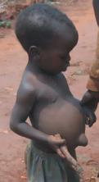
kwashiorkor
Introduction
Kwashiorkor is a disease caused by a lack of protein in the diet
Children and adolescents require protein for and development
It occurs most commonly in area of famine and limited food supply
Symptoms
plump appearance due to Edema , dry and brittle hair
Dermatitis-depigmented
Dry wrinkled skin , bulging of eyes, diarrhoea, loss of appetite
Anaemia , retarded growth
Major cause
lack of protein in the diet
Lack of nutritional knowledge
Limited of food supply

Slide 10
overnutrition
………………

Slide 11
obesity
Intro-
Obesity is an excess of body fat , it causes many health problems like heart disease, diabetes & high BP
Prevention by consuming fewer calories, increasing activity & exercise & by eating modified diet.
Obesity are two types
1. Android obesity
2. Gynoid obesity
Android- accumulation of excess fat in the central abdominal
Gynoid- fat accumulation lower part of the body

Slide 12
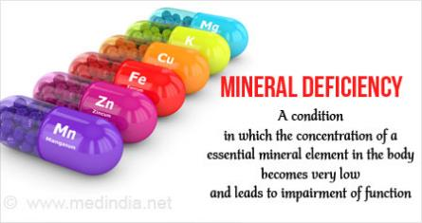
Mineral deficiencies
minerals are inorganic nutrients that include trace elements such as iron, iodine along with the micronutrients such as calcium
Prevention- eating simple wholesome food
Such as groundnut, soyabean, pulses, etc.
Fermentation and sprouting retain and
Increase the nutritional value of food

Slide 13
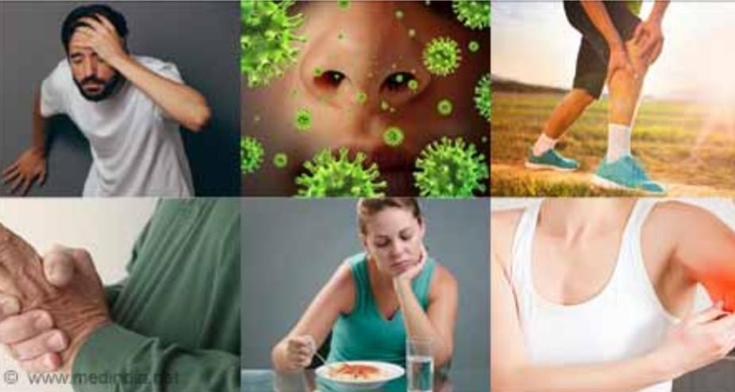
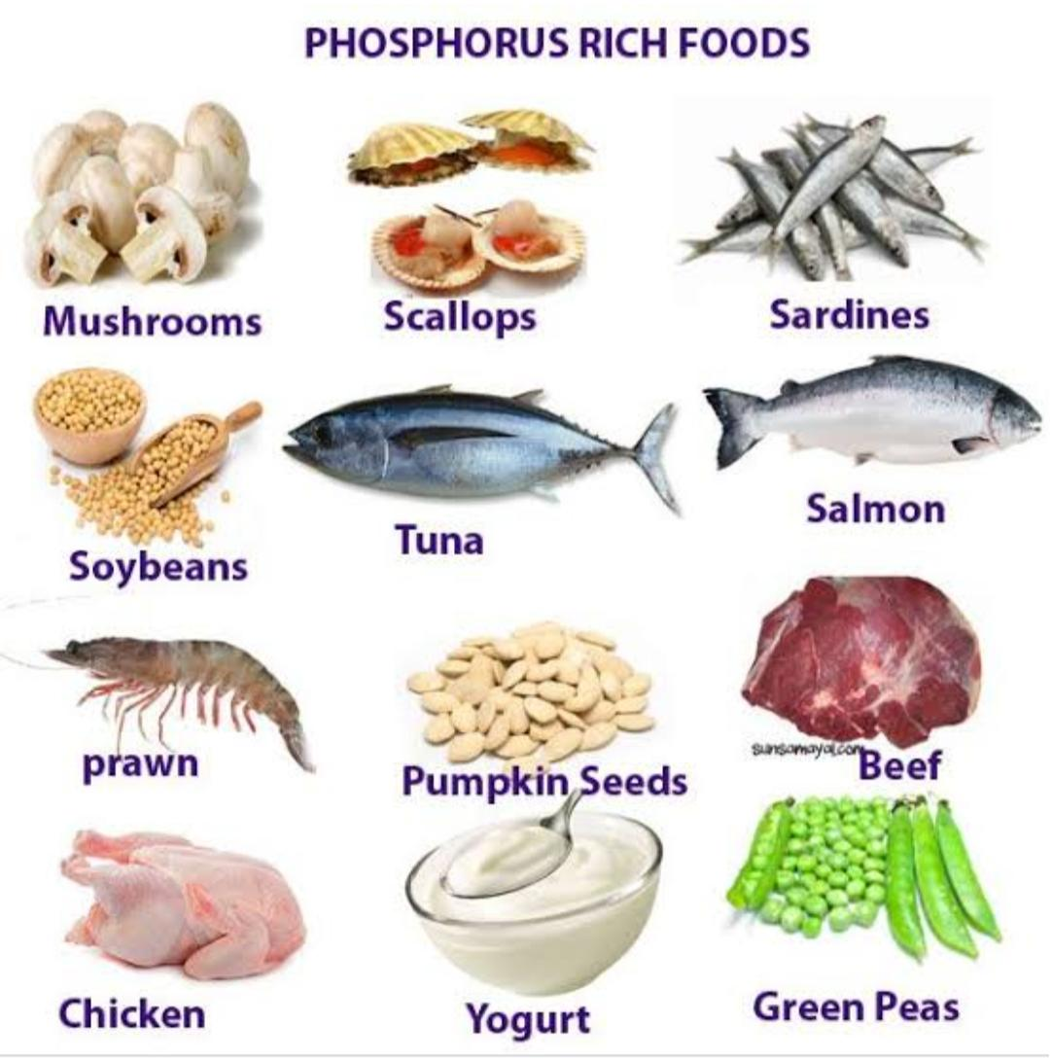
PHOSPHORUS DEFICIENCY
• Lack of phosphorous in the diet makes the bones weak and brittle. Improper functioning of the heart and muscles. Genetic material in our body are not formed properly.
• Symptoms: Bones and teeth are fragile. Disorders in the muscular system.
• Treatment: Diet should contain milk, green vegetables and cereals.

Slide 14
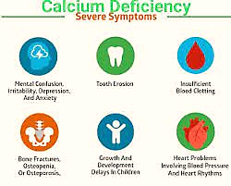
calcium deficiencies
Treatment – ingestion of calcium rich food into your diet like – milk, oatmeal, almonds etc.
Calcium – major constituent of bones & teeth
Imp for – blood clotting, excitability of muscles
Daily requirement – children :
800mg – 1.2g
Adults : 800mg
Lack of calcium in the diet leads to a deficiency disease called hypocalcemia
Hypocalcaemia – in hypocalcaemia there are lower than average levels of calcium in the liquid part of blood (plasma)
Blood calcium level goes abnormally high
Symptoms – muscle cramps, confusion, paresthesia, tingling in lips & fingers, tetany, numbness, seizures

Slide 15
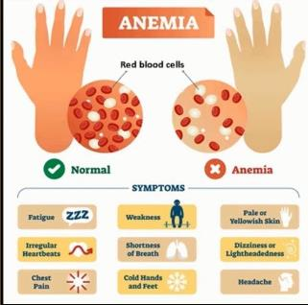
Iron deficiencies
Iron– iron is the main constituents of haemoglobin
Imp for– production respiratory pigment haemoglobin & myoglobin , enzyme reaction, growth and healthy immune system
Lack of iron in the diet
Leads to deficiency disease
called anaemia
Anaemia- low haemoglobin and reduced no. of blood cells
Symptoms- poor oxygen delivery (shortment of breath), pale skin, loss of appetite, fatigue
Treatment- take a iron rich foods into a diet like – meat, beans, chicken, peas and tofu etc.

Slide 16
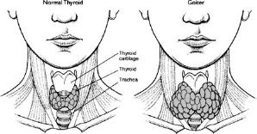
Iodine deficiencies
In children, iodine deficiency cause stunted mental and physical development
Treatment- iodine deficiency can be avoided by using iodised salt in the diet .it is advised to have sea food which are rich in iodine
Iodine- iodine is essential component of the thyroid hormones thyroxine (T4) and triiodothyronine (T3)
imp for- essential for production of thyroid hormone
Lack of iodine in the leads to a deficiency disease called goitre
Goitre - it is the irregular growth of the thyroid gland. The thyroid is a butterfly-shaped gland located at the base of the neck just bellow the Adam’s apple .
Symptoms- thyroid gland does not function properly. In adults, goitre results in swelling of glands near the throat

Slide 17
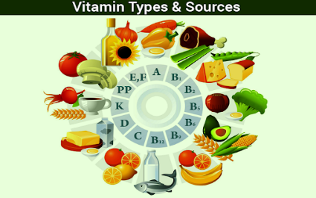
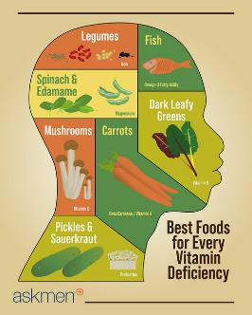
Vitamin deficiencies
Vitamin- are organic compounds
Are present in all natural food
Imp for- growth, reproduction & the maintenances of health
Are NON-CALORIC
Needed in a minute quantity
Thirteen vitamins are necessary for health
Vitamins A,D,E and K are fat-soluble and all others are water- soluble
Lack of vitamin in the body leads to deficiency disease

Slide 18
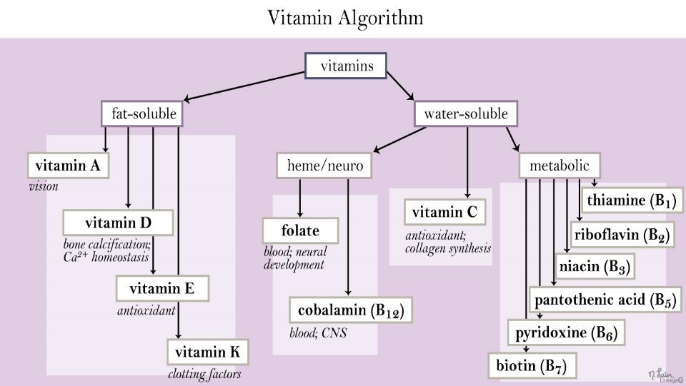

Slide 19
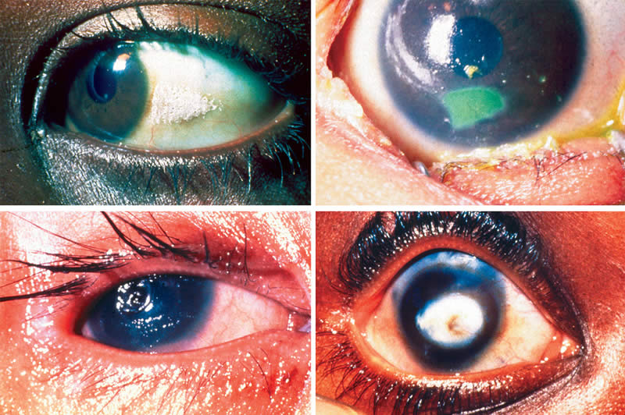
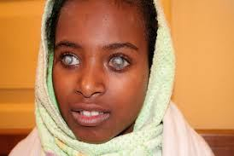
VITAMIN A
• Lack of vitamin A in the diet causes loss of vision.
• Symptoms: Night blindness, i.e. poor vision in dim light, dryness in the mouth.
• Treatment: Diet should contain carrot, mangoes, butter and egg yolk. These will help in development of vision.

Slide 20
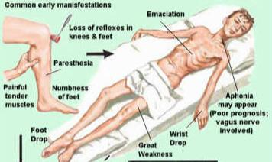
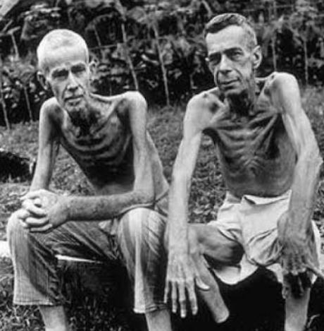
VITAMIN B1
• Lack of vitamin B1 in the diet causes a deficiency disease called beriberi.
• Symptoms: Loss of weight, weak muscles, paralytic effect.
• Treatment: Beans, meat, eggs and corn help in avoiding beriberi. Diet rich in vitamin B1 helps in curing the disease.

Slide 21
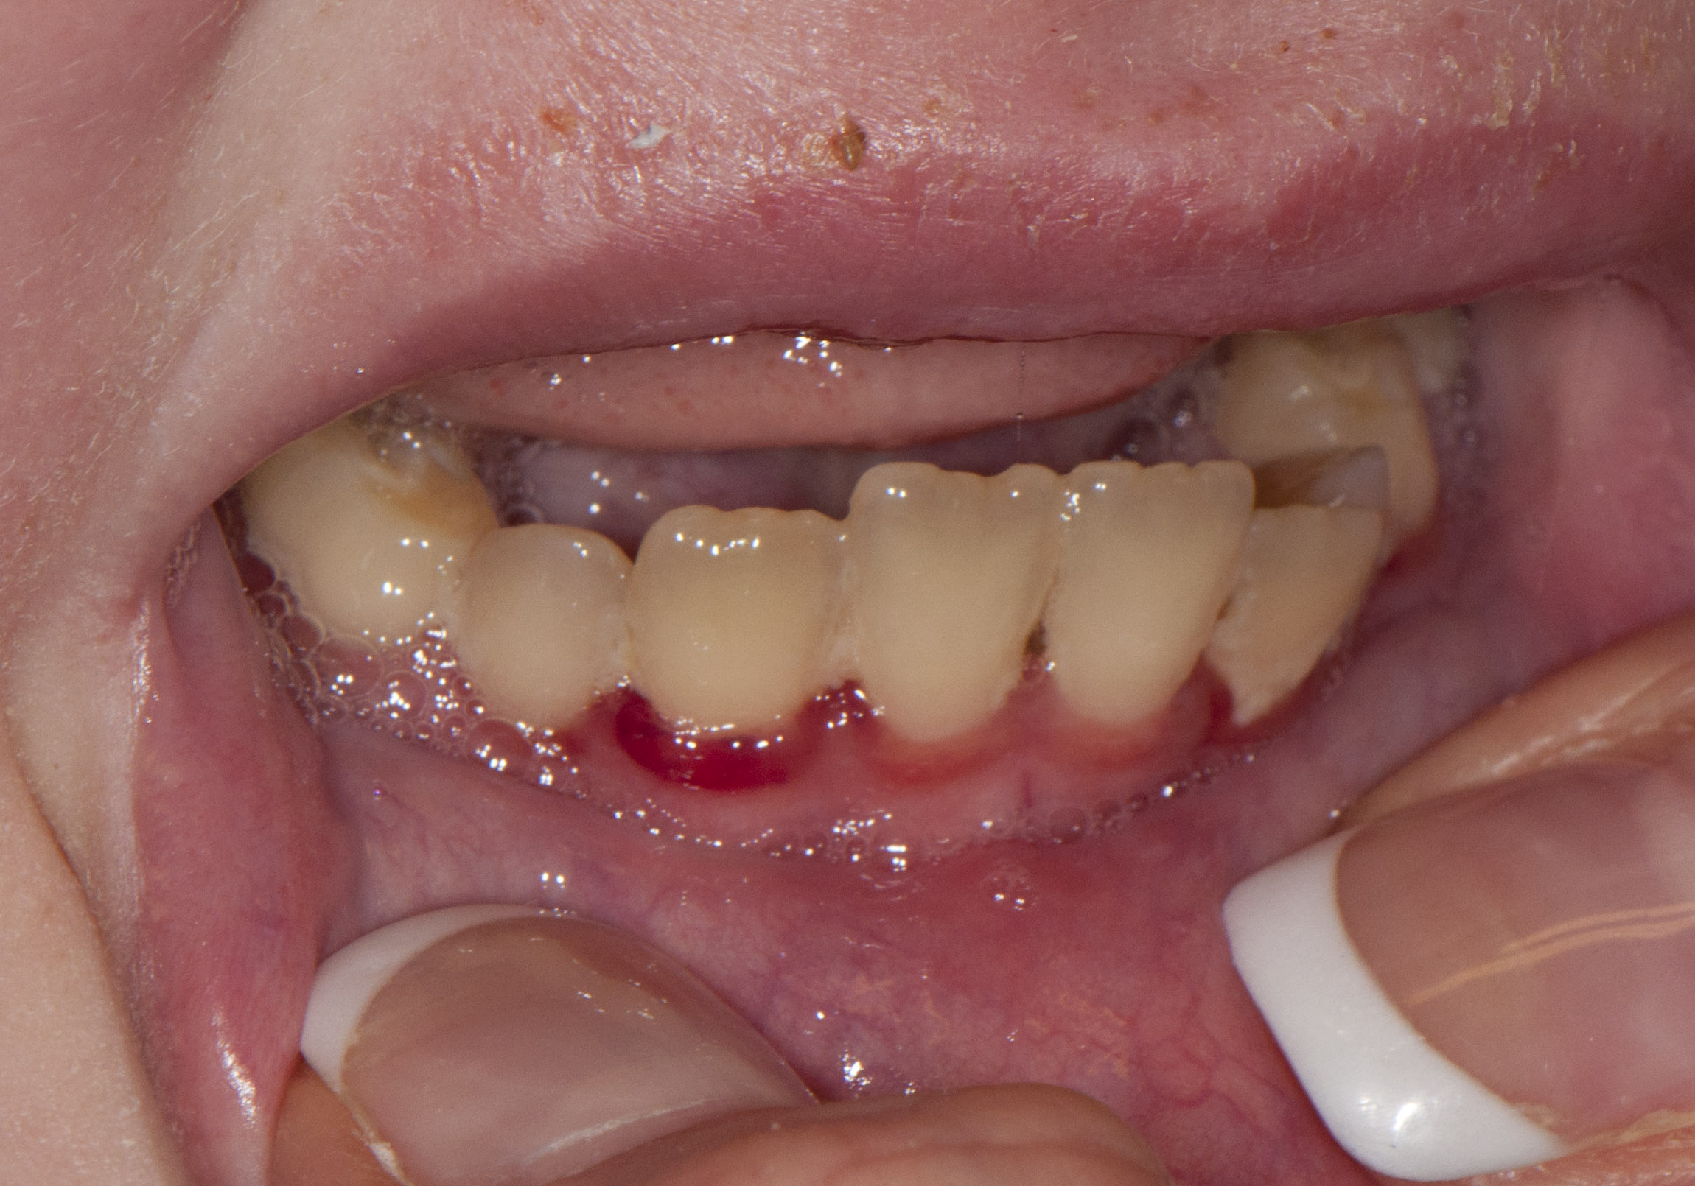
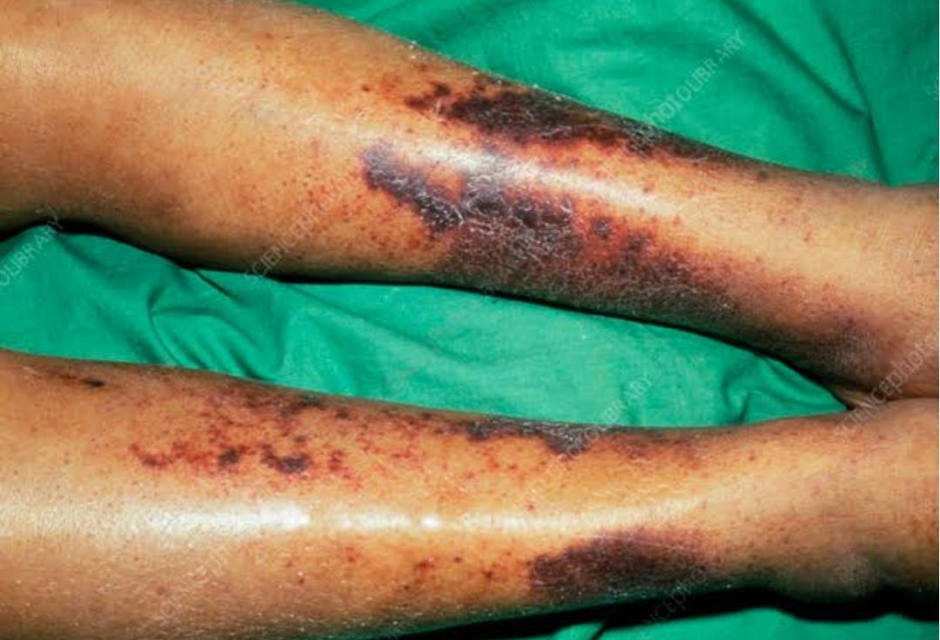
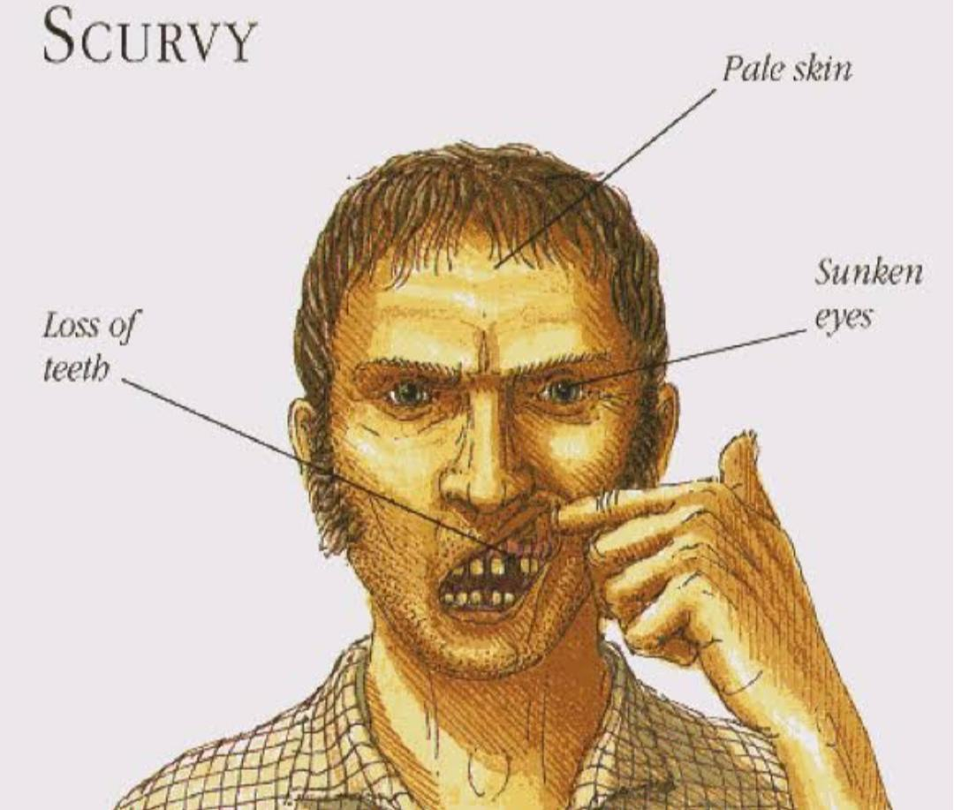
VITAMIN C
• Lack of vitamin C in the diet causes a deficiency disease called scurvy.
• Symptoms: Bleeding gums, swelling of joints. Moreover, wounds take longer time to heal.
• Treatment: Oranges, tomatoes, lemon, guava and amla are rich in vitamin C. Consuming the above fruits help us to avoid scurvy.

Slide 22
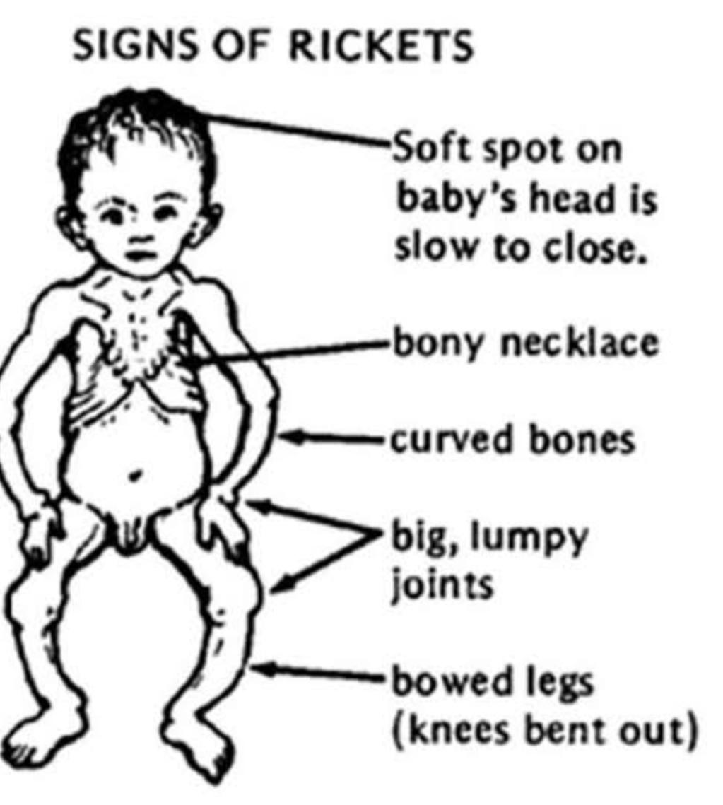
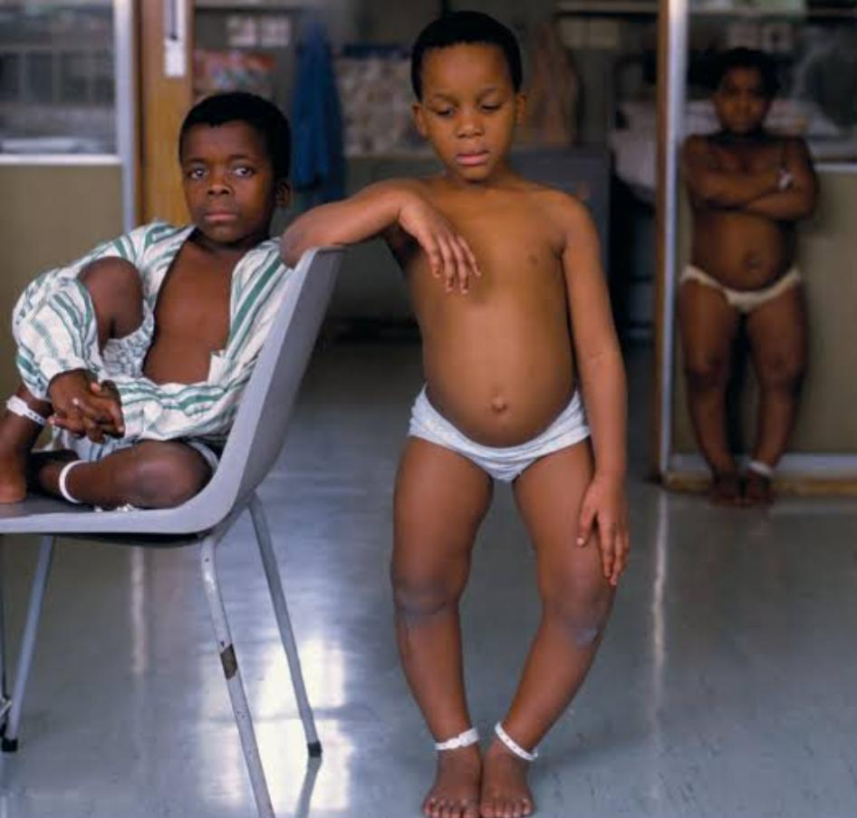
VITAMIN D
• Lack of vitamin D in the diet causes a deficiency disease called rickets.
• Symptoms: Deformed and soft bones, decaying teeth.
• Treatment: Diet should include fish, eggs, milk and butter to avoid rickets. In addition, exposure to sunlight produces vitamin D in the body.

Slide 23
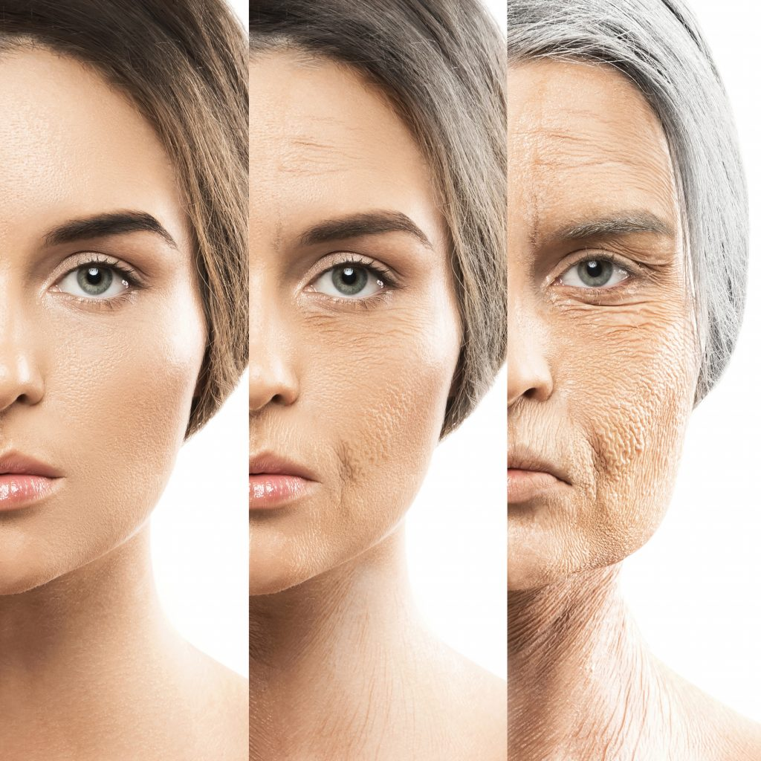
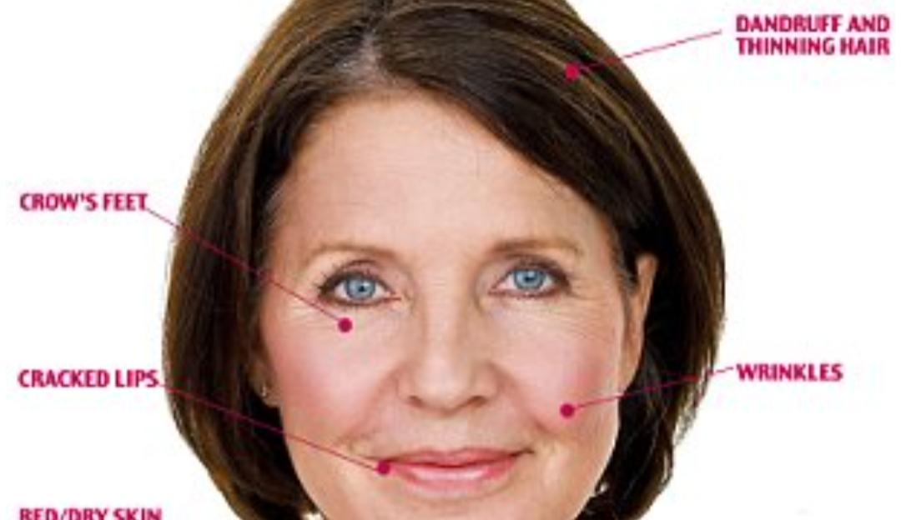
VITAMIN E
• Lack of vitamin E results in early ageing.
• Symptoms: Wrinkles on face and body skin.
• Treatment: Diet should include milk, eggs etc.

Slide 24
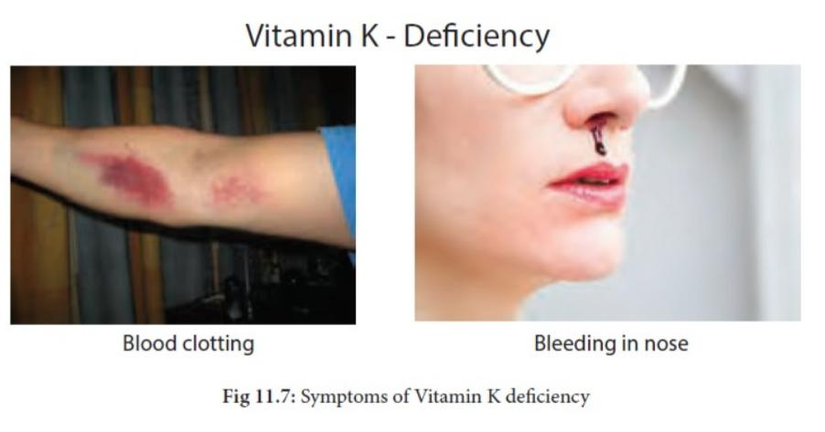
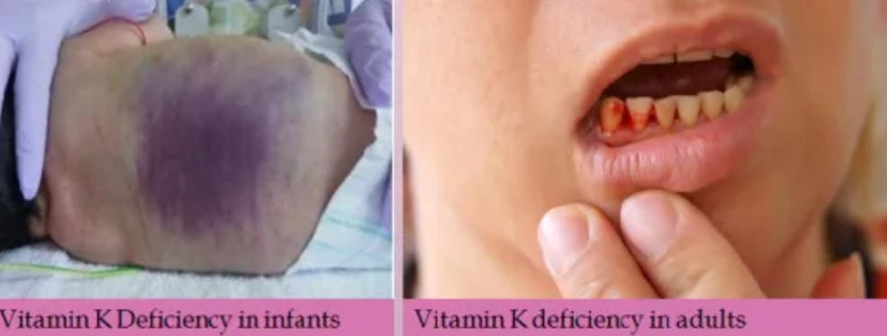
VITAMIN K
• Lack of vitamin K results in delayed clotting of blood.
• Symptoms: Excess bleeding from injuries.
• Treatment: Diet should include fish liver oil, milk eggs etc.

Slide 25
SOME OTHER MINERAL DEFICIENCIES
MINERAL | DEFICIENCY DISEASE/SYMPTOMS | MAJOR SOURCES
MAGNESIUM | Neuromuscular weakness, irritation | Cereals, vegetables, fruits,milk
POTASSIUM | Muscular weakness,mental confusion | Fruits,nuts, vegetables
COPPER | Anemia,menke’s disease | Organ meats, cereals,leafy vegetables
ZINC | Growth retardation,poor wound healing, hypogonadism | Meat,fish,milk
COBALT | Pernicious anemia | Foods of animal origin
FLUORINE | Dental caries, osteoporosis | Drinking water
SELENIUM | Muscular degeneration, cardiomyopathy | Organ meats,sea foods
CHROMIUM | Impaired glucose tolerance | Brewer’s yeast , meat, whole grains

Slide 26
Nutritional problem in India
A survey in south India has revealed that about 1% children aged 1-5 years showed signs of kwashiorkor , 2% marasmus and 3-5 % vitamin A deficiency
Community studies have shown that many mother give only breast milk to children up to 2 years. Thus, no additional food is added to the child's diet.
Papaya which is rich in vitamin A is considered as a hot food that will cause miscarriage is avoided by pregnant women.
It is a belief that if a pregnant woman eats more the baby will be big and delivery difficult, so expectant mothers are not fed adequately both in quality and quantity
Nutritional problems like protein energy malnutrition (PEM) and Anemia , vitamin A deficiency, this occurred in large no of children's in India
The diet and nutritional status of urban slum children in India is far away from satisfactory.
Major nutritional problem in India are protein energy malnutrition (PEM) ,vit-A defi Cincy, iron deficiency, Anemia and iodine deficiency disorders (IDD).

Slide 27
Parasitic disease

Slide 28
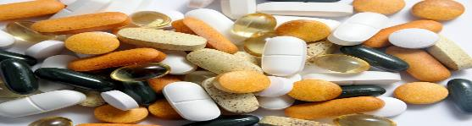
introduction
By definition, parasites are those animals which live at the expense of their host whereas other symbiotes live in mutual benefit with host (mutualist) or live without benefit or detriment to host (commensals) .
there is a biochemical interaction between host and parasite ; they recognize each other, ultimately at the molecular level, and host tissues are stimulated to react some way.
A Parasitic disease is an infection caused or transmitted by a Parasite. Many Parasites do not cause diseases. Parasitic infection can affect practically all living organisms, including plants and animals

Slide 29
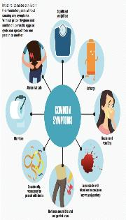
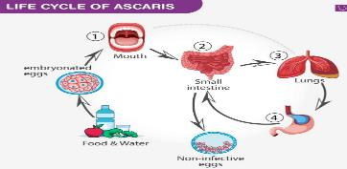
Ascariasis
Caused by the parasitic roundworm Ascariasis lumbricoides.
Particularly prevalent in tropical region And in areas of poor hygeine
The roundworm lives in intestines of humans
Sources- from soil and vegetation on which fecal matter containing eggs has been deposited
Ingestion of infective eggs from soil contaminated with human feces and transmission
Ingestion of infective eggs from soil contaminated with human feces and transmission
Contaminated vegetables and water
Intimate contact with pets in contact with soil
Treatment- Treatment by Albendazole & Mebendazole and diagnosis by examining a stool sample for parasites & ova, MRI, CT scan etc.

Slide 30
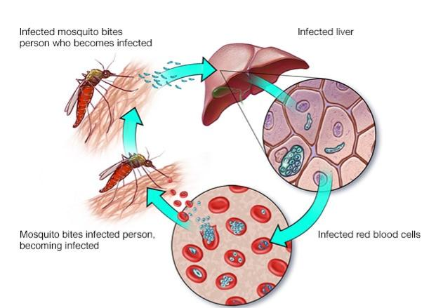
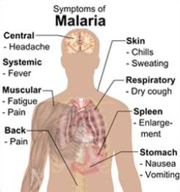
2. MALARIA
• Caused by a protozoan parasite, Plasmodium.
• Four species of plasmodium causes human malaria-P.vivex, P.falsipurum, P.malaria, P.ovale.
• Transmission- through a bite of female anopheles mosquito. In man , the Parasite attack the liver cell & RBCs.
• common in tropical and subtropical countries. Each year nearly 290 million people are infected with malaria, and more than 400,000 people die of the disease.
• Treatment by various drugs- chloroquine, doxycycline, quinine , mefloquine.

Slide 31
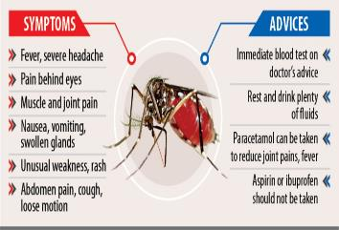
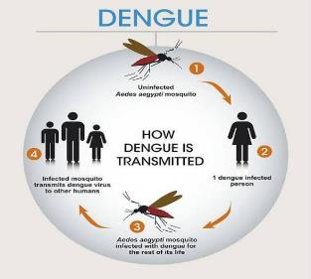
dengue
Mosquito-borne viral disease caused by Dengue virus
Transmitted by Aedes aegypti mosquitos which carry the dengue virus, which has four varied serotypes to infect human beings
more common in subtropical & tropical regions
Diagnosis:- isolation of virus by culture, blood tests , and physical examination
Prevention:- wear protective clothing use mosquito net, repellants, keep doors & windows closed, keep your surrounding clean

Slide 32
SOME OTHER PARASITIC DISEASES
DISEASE | CAUSING ORGANISM | SYMPTOMS
Amoebiasis | Entamoeba histolytica | Diarrhoea, stomach pain.
Leishmaniasis | Leishmania donovani | Weakness,fever, enlarged liver, spleen.
Giardiasis | Giardia lamblia | Fatigue,nausea,loss of appetite.
Toxoplasmosis | Toxoplasma gondii | Muscle pain,fever, headache.
Trichomoniasis | Trichomonas vaginalis | General itching,foul-smelling vaginal discharge.
Sleeping sickness | Trypanosoma brucei | Fever, headache, joint pain.
Chagas disease | Trypanosoma cruzi | Swelling,fever,skin rashes.
Filariasis | Wucheria bancrofti | Damage to lymph system, swelling in legs,arms & genitals.
Schistosomiasis | Schistosoma(Flukes) | Itchy & rashy skin,fever etc.

Slide 33

Thanks
This Photo by Unknown Author is licensed under CC BY-ND

